Slide 1
L KMe Cosmeticos
Vijay A Vincent - 11920052
Rashi Jain - 11920010
Ravikanth MV - 11920046
Mehul Sadavarte - 11920100
Amritpal Singh Bedi - 11920017

Slide 2

Problem Statement: L KMe -Shall We Go Organic?
Need market analysis to understand the preferences of Indian consumers among two categories of shampoos: “organic” & “non-organic”
©L KMe
1

Slide 3
Executive Summary
L KMe is a cosmetics manufacturer wanting to launch shampoo in India
We, being from data analytics team, have analyzed the customers ratings as per organic and non-organic shampoos from Flipkart.com
The data can be used for further analysis on pricing, ratings, discounted price, or any other feature engineering purpose
©L KMe
2

Slide 4
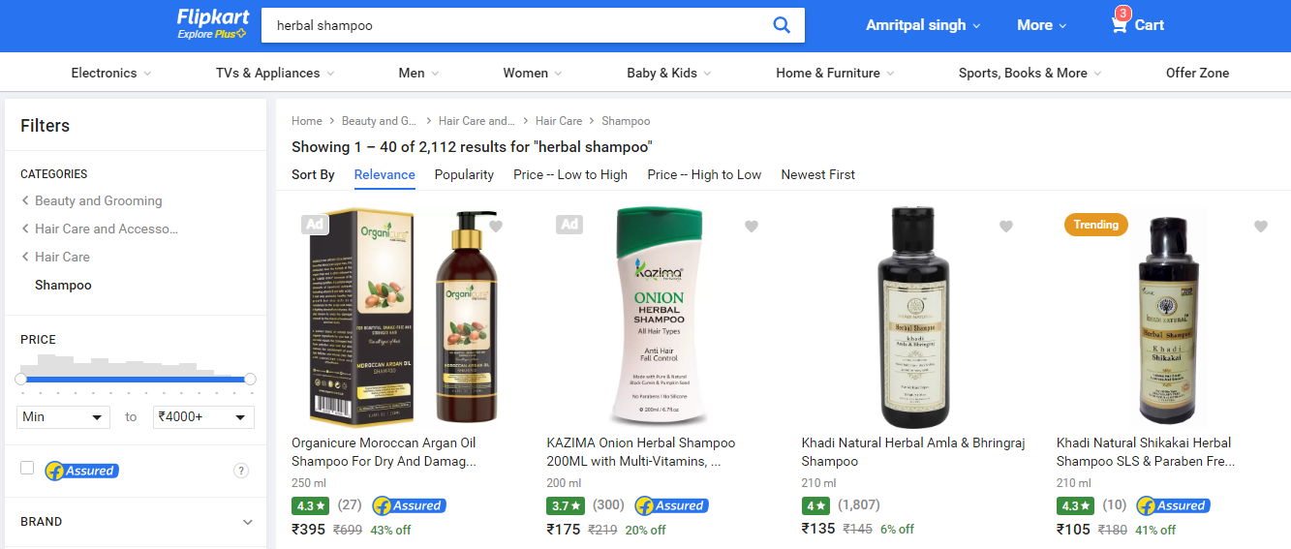
Data Scraping Process
Used Python to perform web scrapping on Flipkart.com and collected data
Variables
- Product names
- Quantity
- Number of Reviewers
- Ratings
- MRP
- Discounted Price
Stored in csv file for further analysis
©L KMe
3

Slide 5
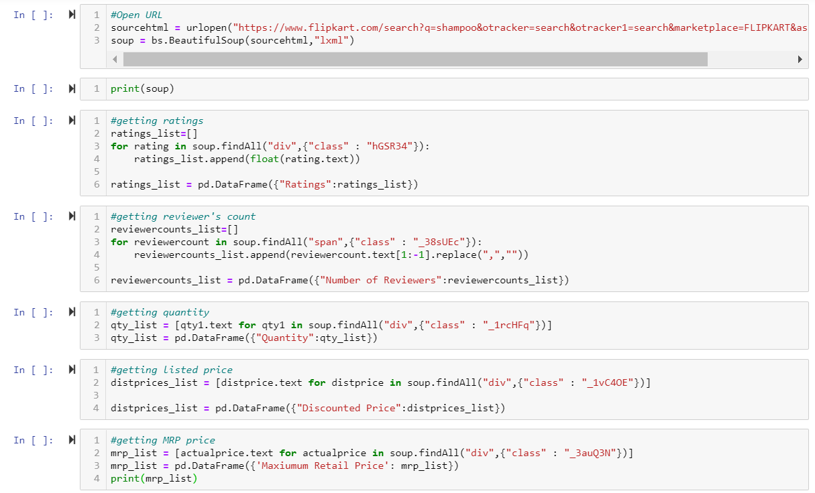
Python Code Screen Shot
Reference packages and libraries:
- bs4
- csv
- requests
- pandas
- BeautifulSoup
©L KMe
4

Slide 6
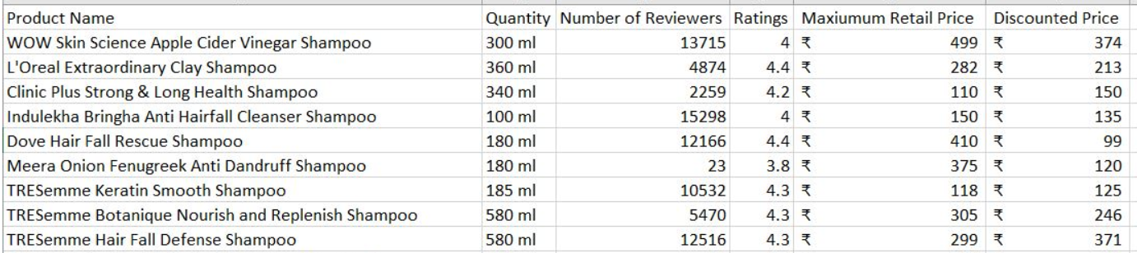
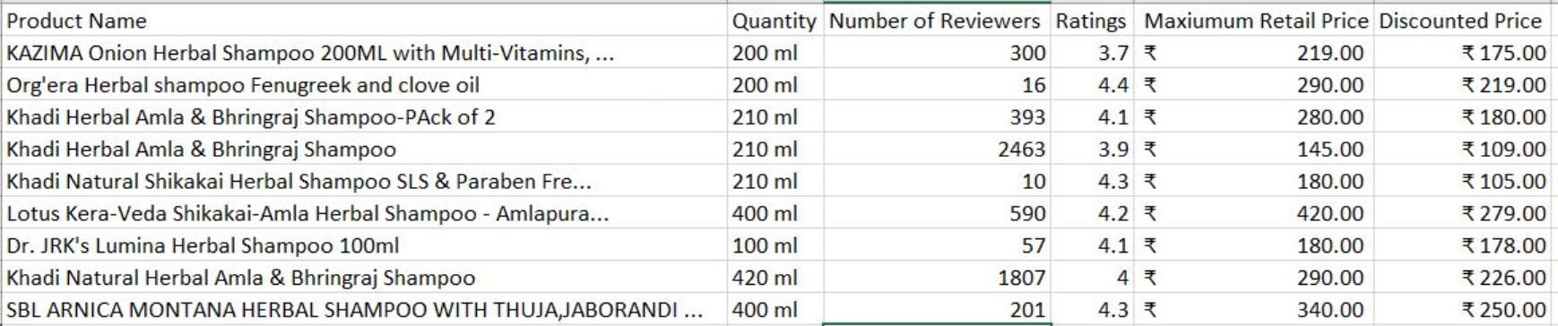
Non-organic Shampoo Data Screen Shot
Organic Shampoo Data Screen Shot
©L KMe
5

Slide 7
Appendix
Type of Segment | .Py File | Output CSV FIle
Normal Products
Organic Produc
©L KMe
6

Slide 8
Thank You
©L KMe
7

